Slide 1
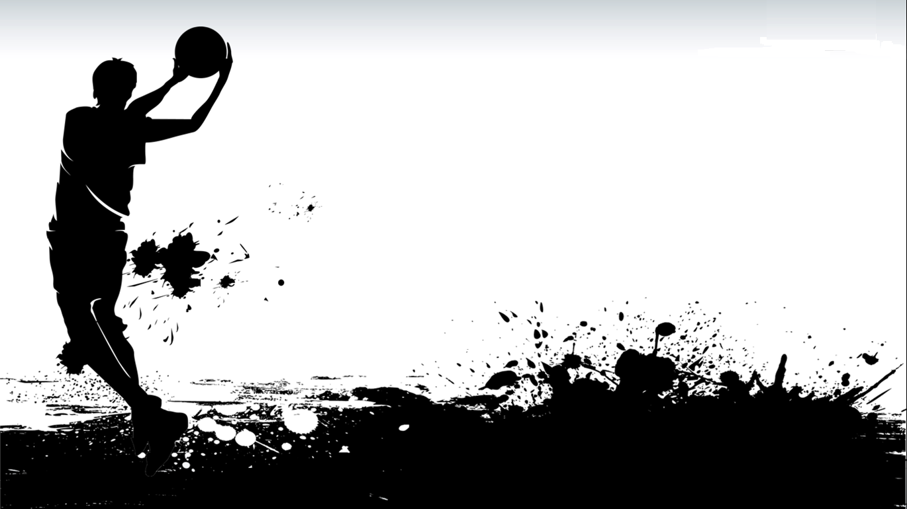
Math In Basketball
Group number 9-17
Mao Ziming 3S2 17(c)
Cheng Dongyan 3S2 01
Zhang Shukai 3S2 24

Slide 2
Objective 2
Quick intro
Objective 1

Slide 3
Terminology
Introduction
Terminology
Bank shot | A shot that hits the backboard before hitting the rim or going through the net.
Free throw line | A restricted area on the court which allow unopposed attempts to score points.
Swish | A shot which goes through the net without hitting the backboard or rim.
Wiggle room | The area on the backboard where ball can go through the net if it hits.

Slide 4
Terminology
Introduction
We: Basketball Fans
Others: Air resistance and rotation
We: 3-D, possibility
Others: 2-D

Slide 5
Introduction
Objectives
● To deduce the function of making
bank shot and making swish on selected points on the court.
● To find the trend of possibility of scoring on selected points on the court.
● To determine the optimum release condition and height of scoring on selected points on the court.

Slide 6
Objectives
Research problems
● What is the path of a swish and bank shot on selected points on the court?
● What is the trend of the possibility to shoot on target on selected points on the court?
● What is the best way and height of scoring on selected points on the court?

Slide 7
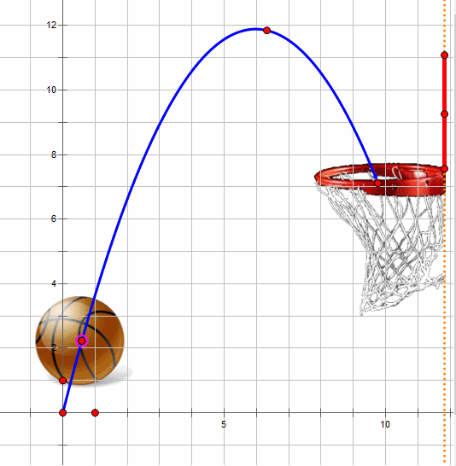
The function of swish
Research problems
Objective 1
The function of bank shot
We assume there is no air resistance and rotation of the ball

Slide 8
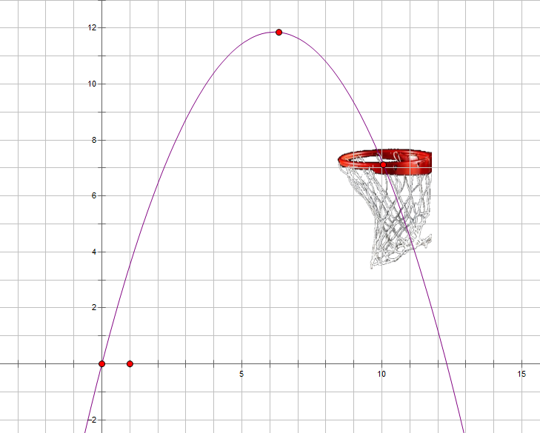
Objective 1
Objective 2
According to the function of oblique projectile,
f(x)
Substituting x₁ and x₂ into f(x)
$$f\left(x\right)=\frac{x\tan{θ}−gx^{2}}{2{(v\cos{θ})}^{2}}$$
h
where
x₁ ≤ x ≤ x₂,
f(x₁) > h
f(x₂) < h
0
$$\text{x}\text{1}$$
x₂
x
2015/7/24

Slide 9
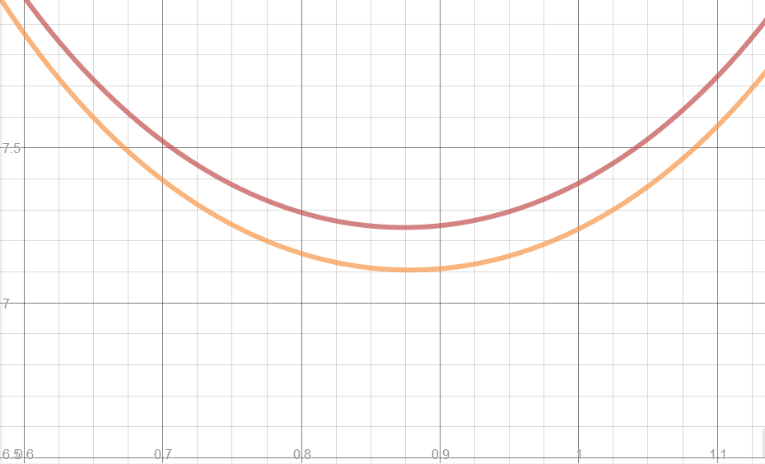
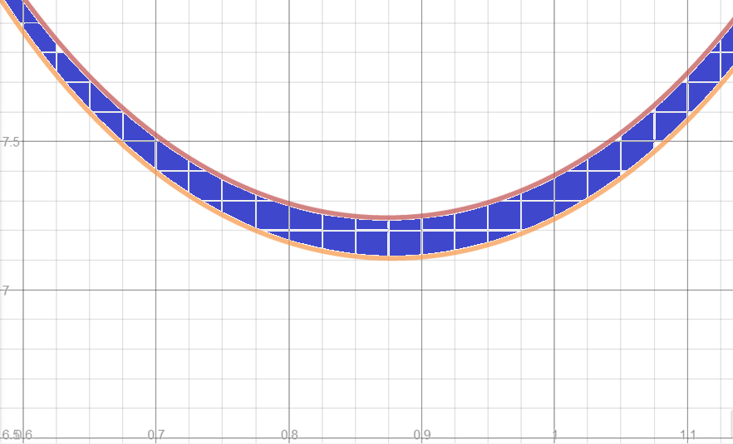
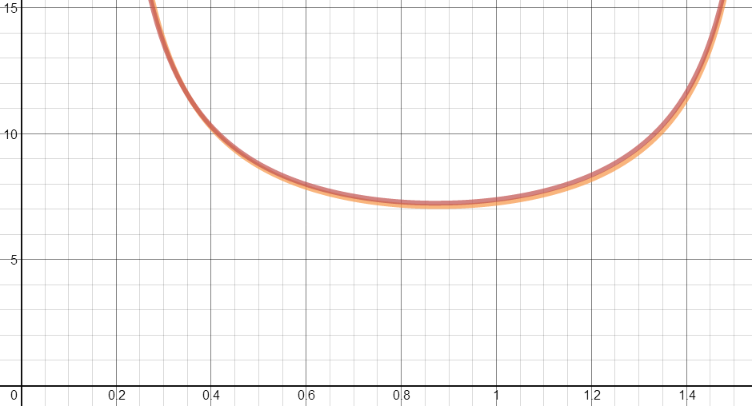
Objective 1
Objective 2
The red curve shows the situation where the ball hit the back of the basket.
The orange curve shows the situation where the ball hit the front of the basket.
$v(θ$)
By changing the subject from f(x) to v, we form the function of v against θ:
$$v(θ)=\frac{\frac{\sqrt{gx^{2}}}{\cos{θ}}}{\sqrt{2(x\tan{θ−y})}}$$
The shaded-part of the graph is the range of θ and v for scoring
$$θ$$
Data retrieved from http://www.sportsknowhow.com/basketball/dimensions/nba-basketball-court-dimensions.html

Slide 10
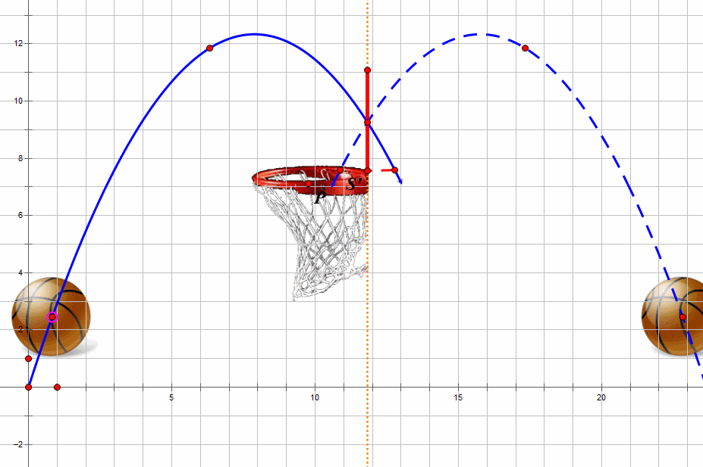
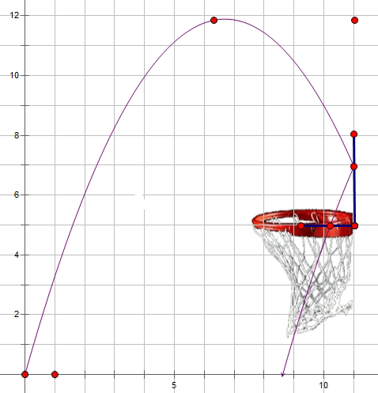
Objective 1
Objective 2
The board is the axis of symmetry.
The bank shot can be imagined as a special swish shot where the basket is symmetrical to the actual net with respect to the
board.
f(x)
h₀
$$f\left(x\right)=\frac{x\tan{θ}−gx^{2}}{2{(v\cos{θ})}^{2}}$$
h₁
Where h₀ > f(x₁) > h₁ f(x₂) < h₁
x₁ ≤ x ≤ x₂,
h₀>f(x₁) > h₁
f(x₂) < h₁
x
x1
x2
2015/7/24

Slide 11
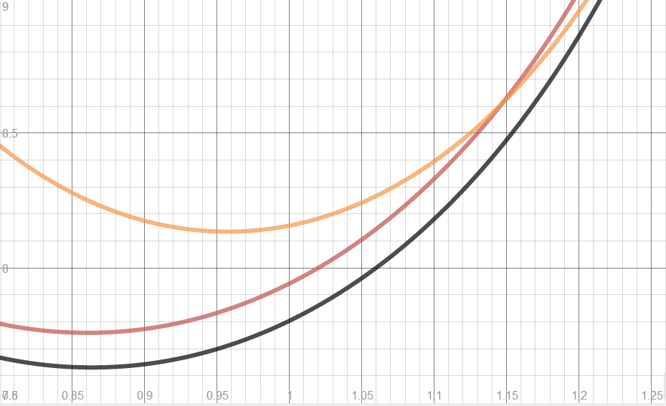
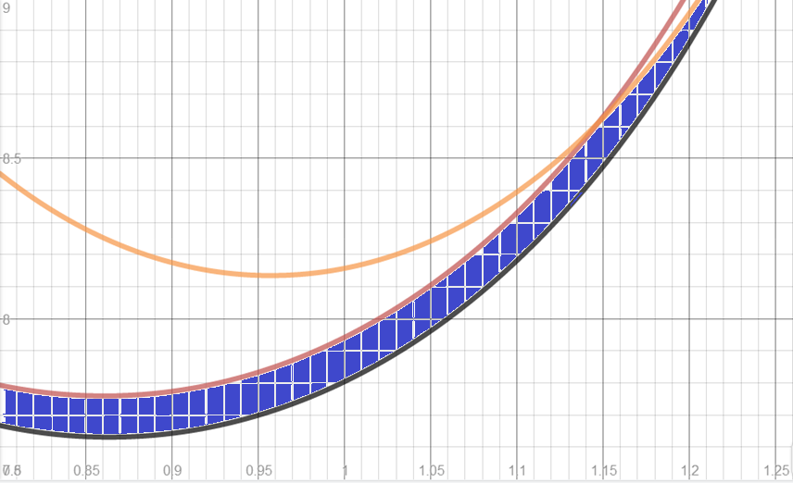
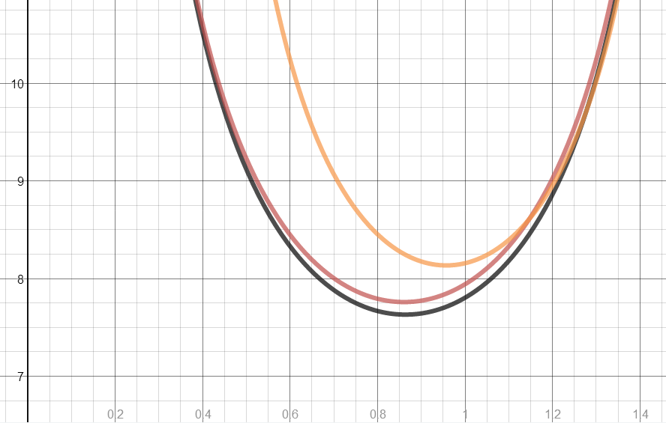
Objective 1
Objective 2
The orange curve shows the situation where the ball hit the top of the board.
The black curve shows the situation when the ball hit the front of the basket.
The red curve shows the situation where the ball hit the back of the basket.
$$v(θ)$$
Change the subject from f(x) to v, we get the function of v against θ:
$$v(θ)=\frac{\frac{\sqrt{gx^{2}}}{\cos{θ}}}{\sqrt{2(x\tan{θ−y})}}$$
The shaded-part of the graph is the range of θ and v for scoring
$$θ$$
Data retrieved from http://www.sportsknowhow.com/basketball/dimensions/nba-basketball-court-dimensions.html

Slide 12
Objective 1
Objective 2
The variation of the shift angle
The analysis of wiggle room
The possibility of scoring

Slide 13
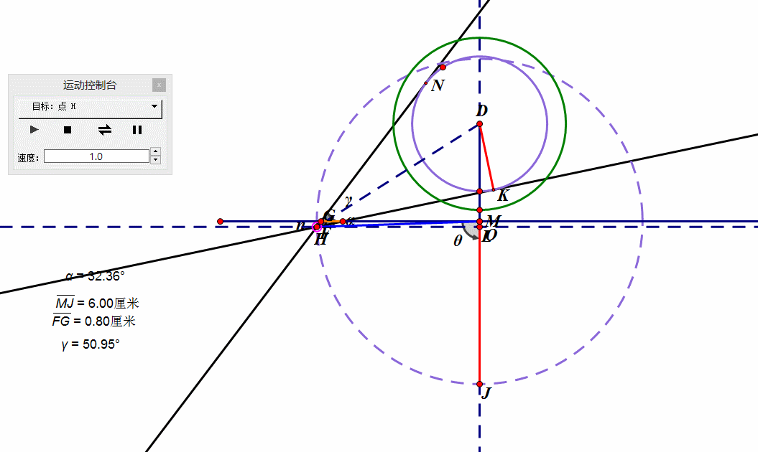
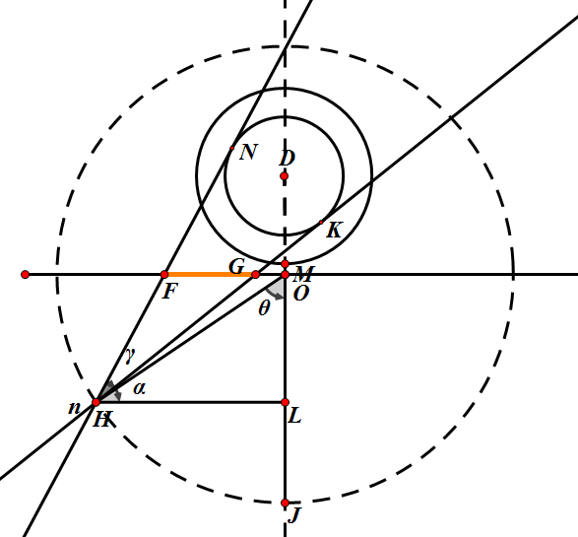
Objective 2
By using trigonometry functions and applying Pythagorean Theorem：
$∠NHK\text{(}\text{γ}\text{)}$=2$∠$DHK =2$\sin^{−1}{\frac{r}{\sqrt{{\left(xcosθ+x \right)}^{2}+{(xsinθ)}^{2}}}}$
As θ decreases, ∠NHK (γ)also decreases
When θ reaches π/2,γ is the biggest.

Slide 14
Objective 2
Through calculation:
s(FM):
wiggle room
$$γ：∠NHK$$
$$α：∠DHL$$
$$s=\frac{xcos(θ)}{\tan{(α−\frac{γ}{2})}}−\frac{xcos(θ)}{\tan{(α+\frac{γ}{2})}}$$
Where:
$$γ=2\sin^{−1}{(\frac{r}{d})}$$
$$α=\tan^{−1}{\frac{x+x_{1}}{x\cos{θ}}}$$
Q
QG - QF

Slide 15
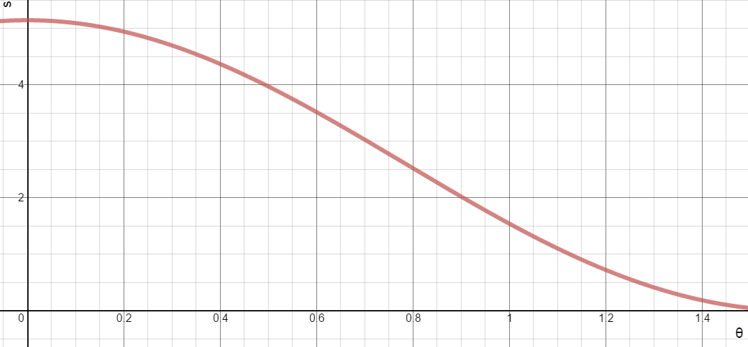
Objective 2
Substitute x, y and r by data and plot the graph
$$s$$
When θ increases, the wiggle room(s) decreases.
$$θ$$
Data retrieved from http://www.sportsknowhow.com/basketball/dimensions/nba-basketball-court-dimensions.html

Slide 16
Objective 2
When the angle between the point of shooting and the zero degree line (θ) increases, the wiggle room(s) decreases, the possibility of scoring decreases.
When θ increases, the shift angle variation (γ) increases, the possibility of scoring increases

Slide 17
Variables
Height of the player (h)
Shifting angle variation (γ)
Wiggle room (s)
Launch angle ($θ$)
Launch speed (v)
Position of the player (x, $α$)
possibility
conclusion
Objective 1
?
?
Objective 2
Objective 3
1. To deduce the function of making
bank shot and making swish on selected points on the court.
2. To find the trend of possibility of scoring on selected points on the court.
3. To determine the optimum release condition and height of scoring on selected points on the court.

Slide 18
References
Duan, R. (2009). The physical model of basketball shooting motion track and hitting rate Science and Technology Consulting Herald Year 2009 number 20 Retrieved on 2 Feb 2015 from
http://wenku.baidu.com/view/1812a541336c1eb91a375d61.html
Silverberg, L.M. (2012). & Wagner, K. (2012). Science Has Calculated the Perfect Basketball Shot Retrieved on 14 Feb 2015 from
http://gizmodo.com/5928074/science-has-calculated-the-perfect-basketball-shot
Gorski, C. (2011). Best “sweet spots” on the backboard Retrieved on 24 Feb 2015 from
http://phys.org/news/2011-03-sweet-backboard.html
Brabandere, S.D. (2014). Basketball: The Geometry of Banking a Basket Retrieved 12 February, 2015 from
http://www.sciencebuddies.org/science-fair-projects/project_ideas/Sports_p064.shtml#procedure
Begley, S

Slide 19
References
(2011). “Nothing but net?” Basketball science has more answers Retrieved on 24 Feb 2015 from
http://www.reuters.com/article/2012/07/21/us-oly-science-bask-adv- idUSBRE86K0BG20120721
Yan, S.S. (2008). Interesting physics in ball games Physics 37 volume year 2008 number 7 Retrieved on 1 Feb 2015 from
http://scholar.google.com.sg/scholar_url?url=http%3A%2F%2Fwww.wuli.ac.cn%2FN%2Farticle%2FdownloadArticleFile.do%3FattachType%3DPDF%26id%3D31255&hl=zh-CN&sa=T&oi=ggp&ct=res&cd=5&ei=lz3QVOm7MceEqgGQ9YHYCA&scisig=AAGBfm3XcoVU6si-tVR5aBJXA1fUTY9inA&nossl=1&ws=1366x673
Sports know how.com PROFESSIONAL-NBA BASKETBALL COURT DIMENSIONS NBA Basketball Court Layout Diagram retrieved on 30 June 2015 from
http://www.sportsknowhow.com/basketball/dimensions/nba-basketball-court-dimensions.html

Slide 20
Web Report
Mibmathinbasketball.weebly.com

Slide 21
Thank you

Slide 22
ANY QUESTIONS?
Picture taken form:
http://satorifrenzy.deviantart.com/art/MIB3-wallpaper-by-satorikun-302439924

