Slide 1
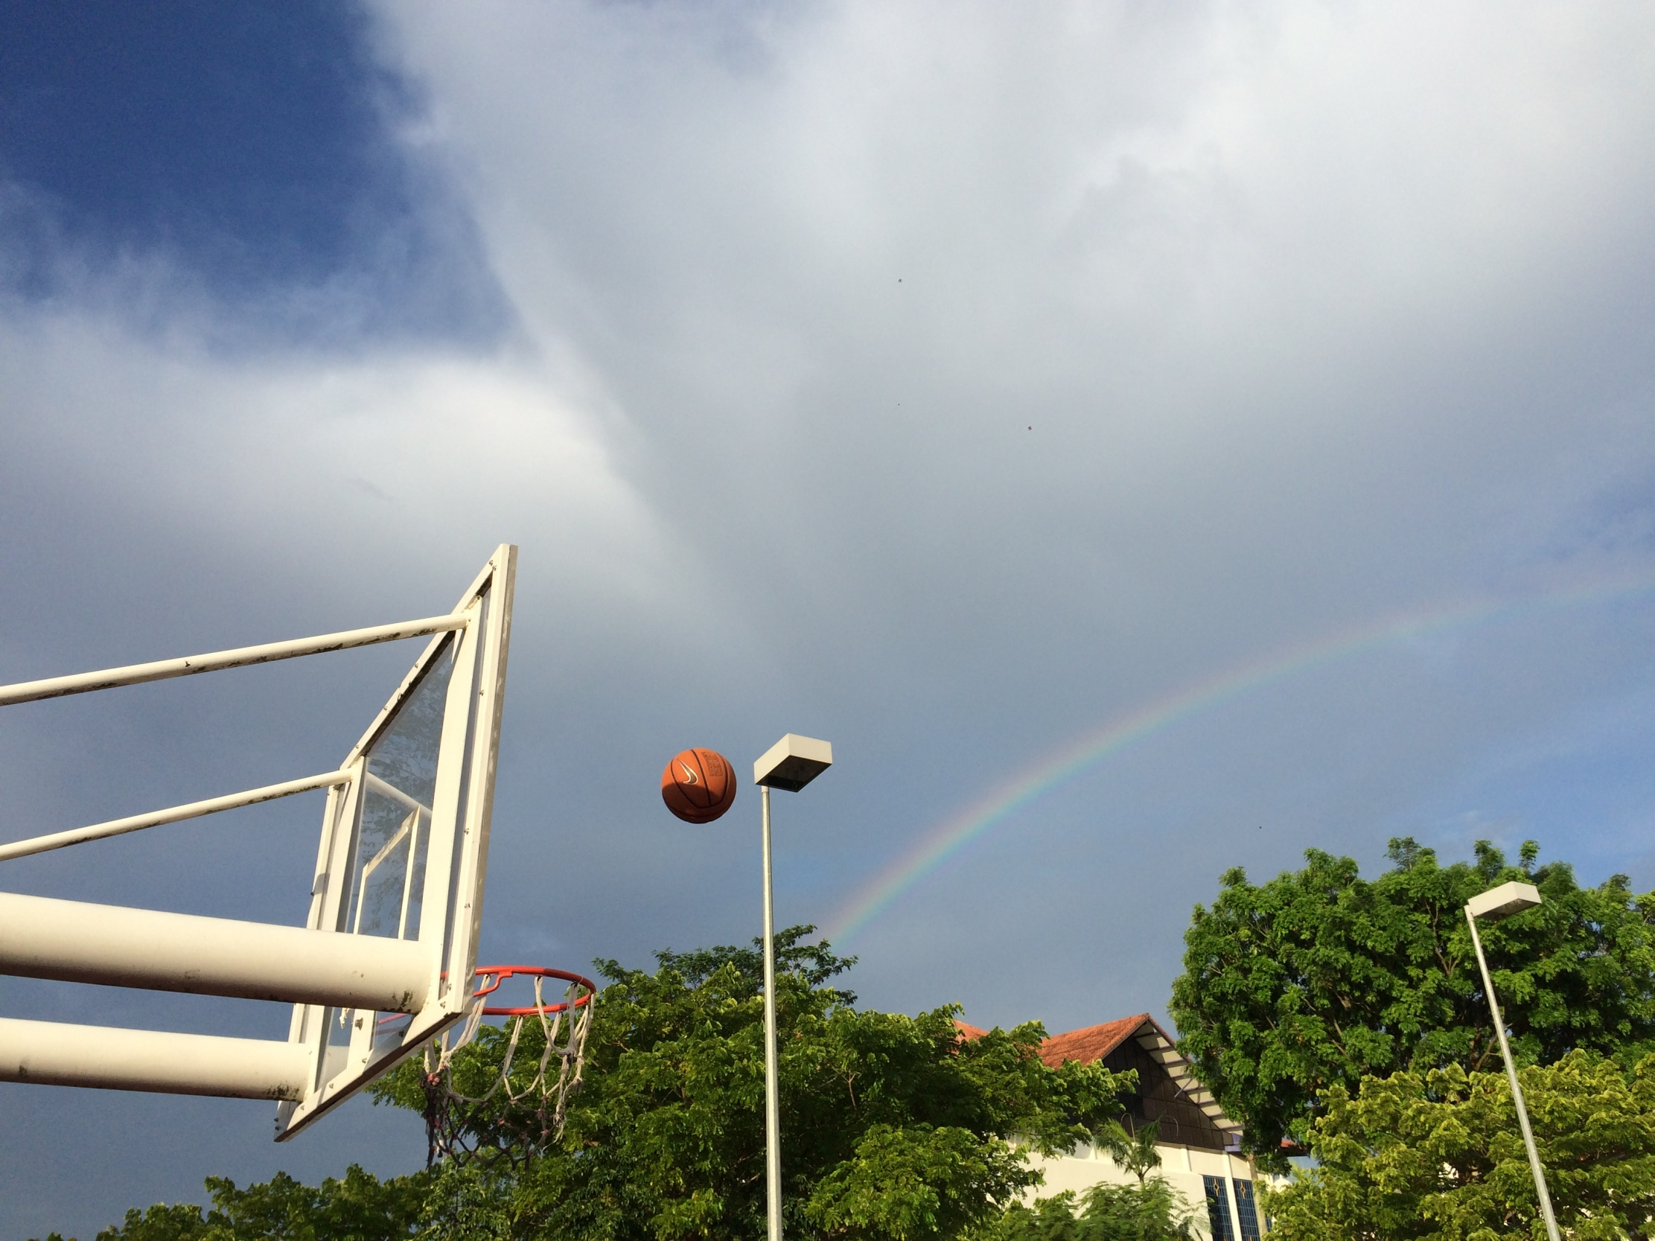
Picture taken from HCIS basketball court

Slide 2
Math In Basketball
Group number 9-17
Mao Ziming 3S2 17(c) Cheng Dongyan 3S2 01 Zhang Shukai 3S2 24

Slide 3
Objective 2
Objective 1
Quick intro
Objective 3

Slide 4
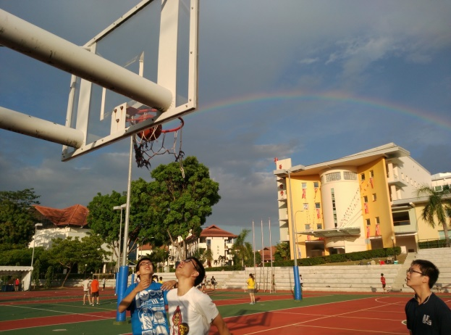
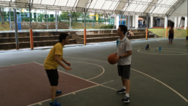
Others: Air resistance and rotation, 2-D
We: 3-D
Possibility of scoring

Slide 5
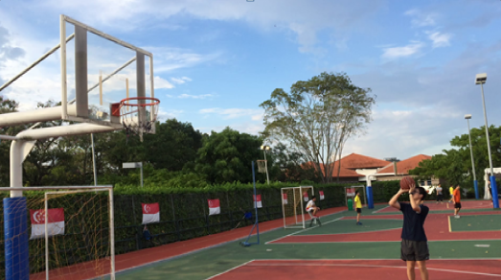
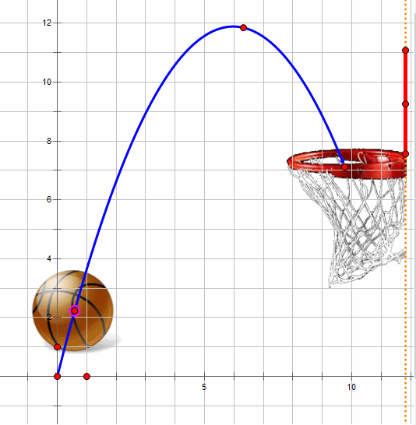
To find the relationship between launch angle and launch speed on selected points on the court in 2-D condition.
To deduce the function of making
bank shot and making swish
A shot which goes through the net without
hitting the backboard or rim.

Slide 6
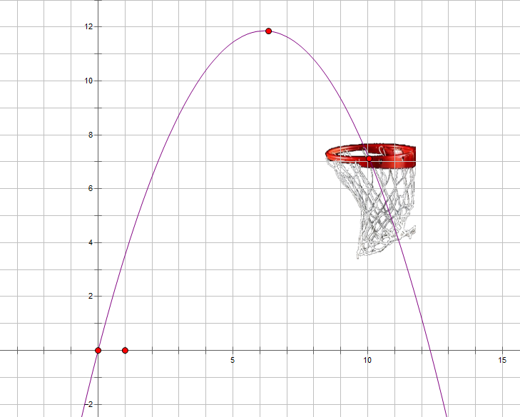
Objective 2
f(x)
According to the function of oblique projectile,
Substituting x₁ and x₂ into f(x)
$$f\left(x\right)=\frac{x\tan{θ}−gx^{2}}{2{(v\cos{θ})}^{2}}$$
h
where
x₁ ≤ x ≤ x₂,
f(x₁) > h
f(x₂) < h
0
$$\text{x}\text{1}$$
x₂
x
2015/8/16

Slide 7
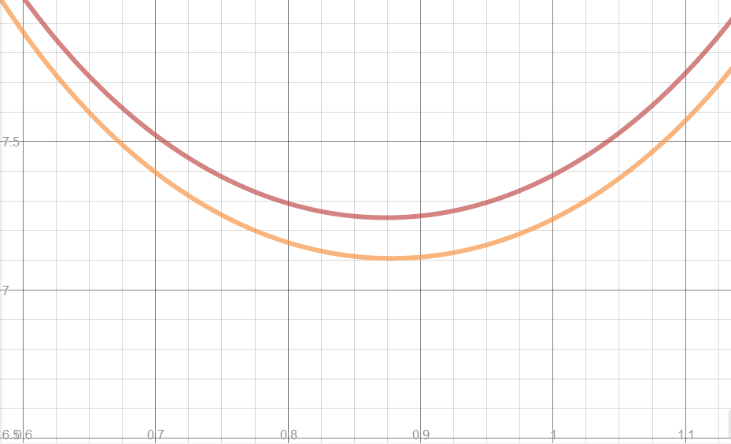
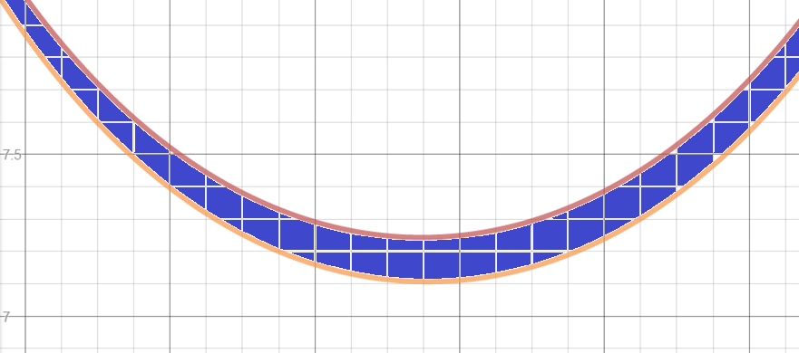
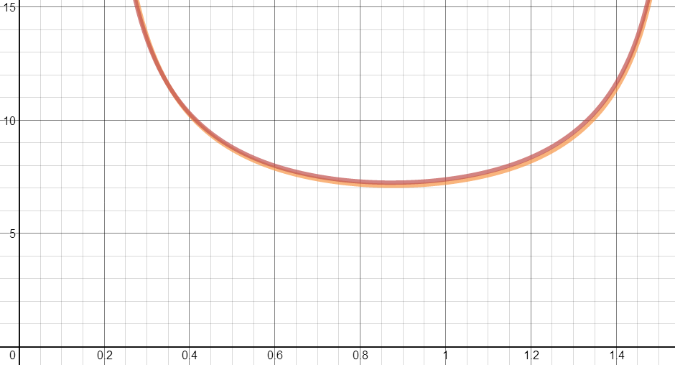
By changing the subject from f(x) to v, we form the function of v against$β$ :
$v(θ$)
The red curve shows the situation where the ball hit the back of the basket.
The orange curve shows the situation where the ball hit the front of the basket.
$$v(θ)=\frac{\frac{\sqrt{gx^{2}}}{\cos{β}}}{\sqrt{2(x\tan{β−y})}}$$
The shaded-part of the graph is the range of$β$ and v for scoring
$$β$$
Data retrieved from http://www.sportsknowhow.com/basketball/dimensions/nba-basketball-court-dimensions.html

Slide 8
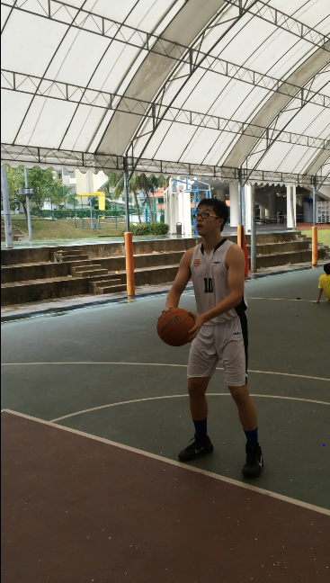
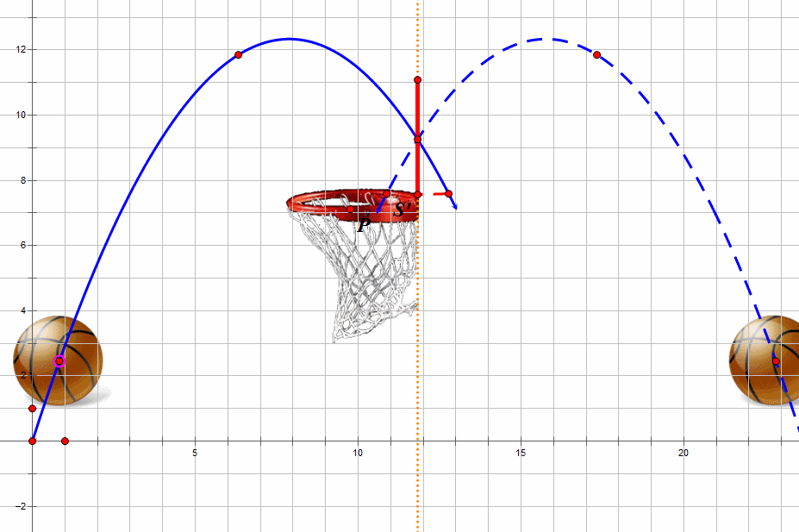
Bank shot
A shot that hits the backboard before hitting the rim or going through the net.

Slide 9
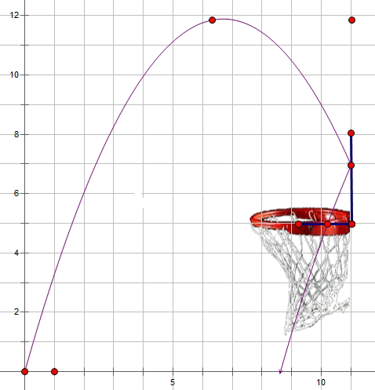
f(x)
h₀
$$f\left(x\right)=\frac{x\tan{β}−gx^{2}}{2{(v\cos{β})}^{2}}$$
h₁
Where h₀ > f(x₁) > h₁ f(x₂) < h₁
x₁ ≤ x ≤ x₂,
h₀>f(x₁) > h₁
f(x₂) < h₁
x
x1
x2
2015/8/16

Slide 10
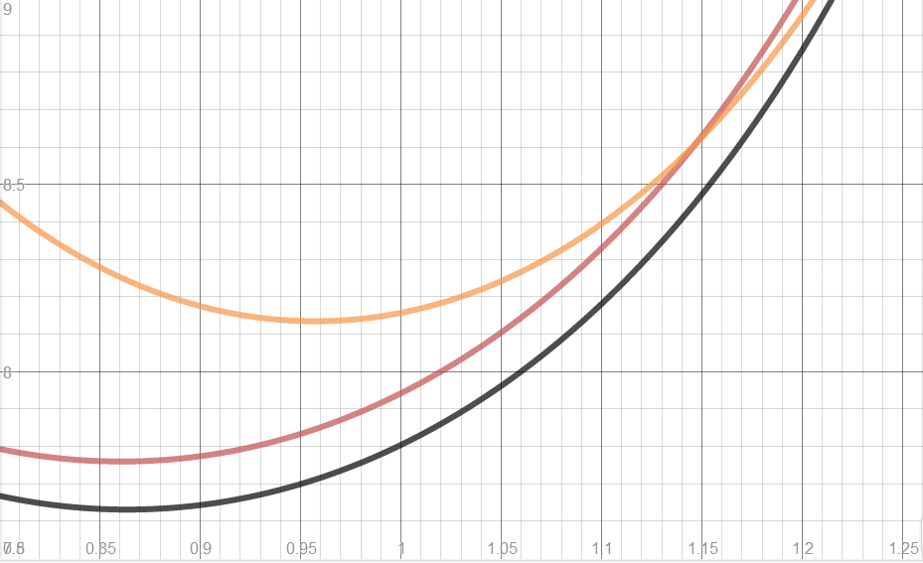
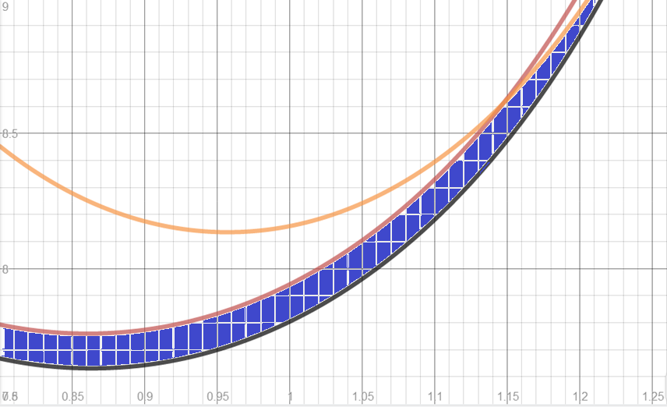
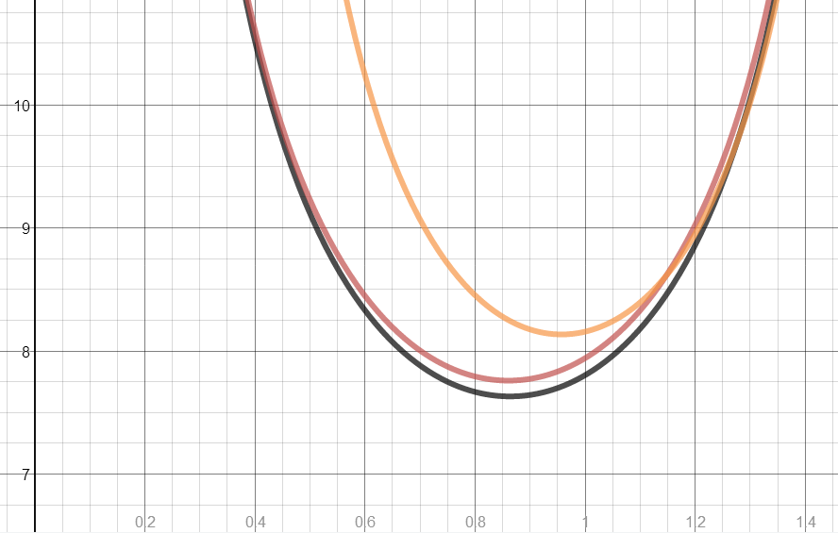
The orange curve shows the situation where the ball hit the top of the board.
The black curve shows the situation when the ball hit the front of the basket.
The red curve shows the situation where the ball hit the back of the basket.
$$v(θ)$$
Change the subject from f(x) to v, we get the function of v against$β$:
$$v(β)=\frac{\frac{\sqrt{gx^{2}}}{\cos{β}}}{\sqrt{2(x\tan{β−y})}}$$
The shaded-part of the graph is the range of$β$ and v for scoring
$$β$$
Data retrieved from http://www.sportsknowhow.com/basketball/dimensions/nba-basketball-court-dimensions.html

Slide 11
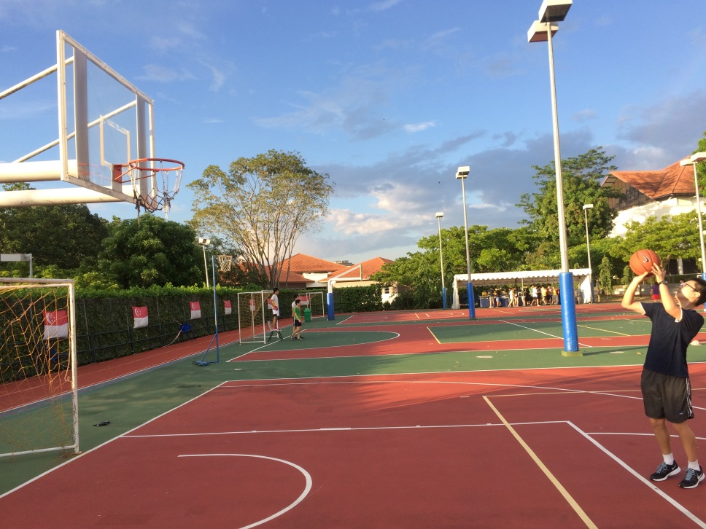
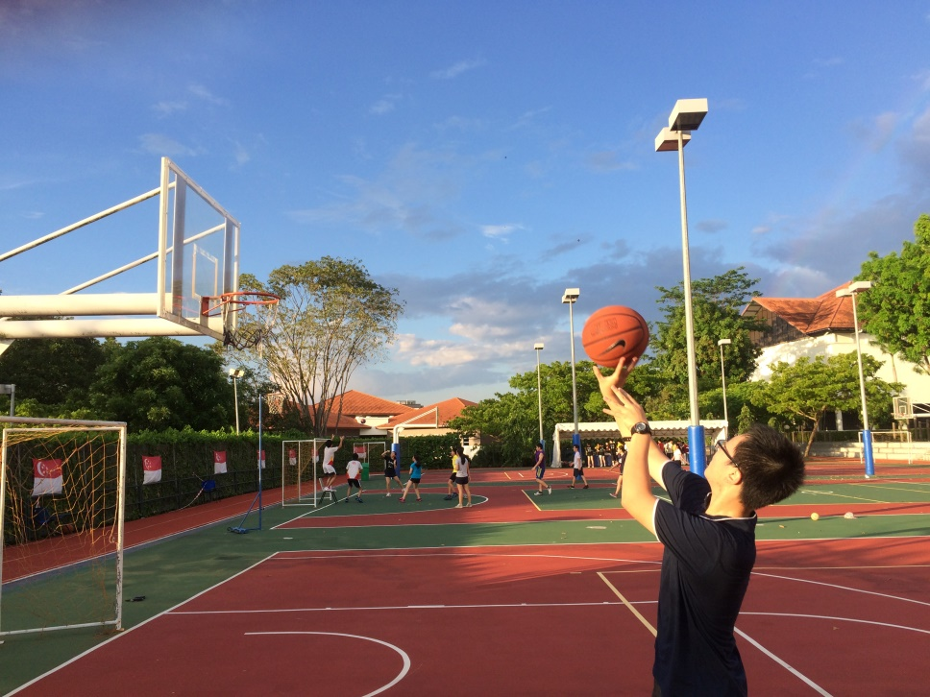
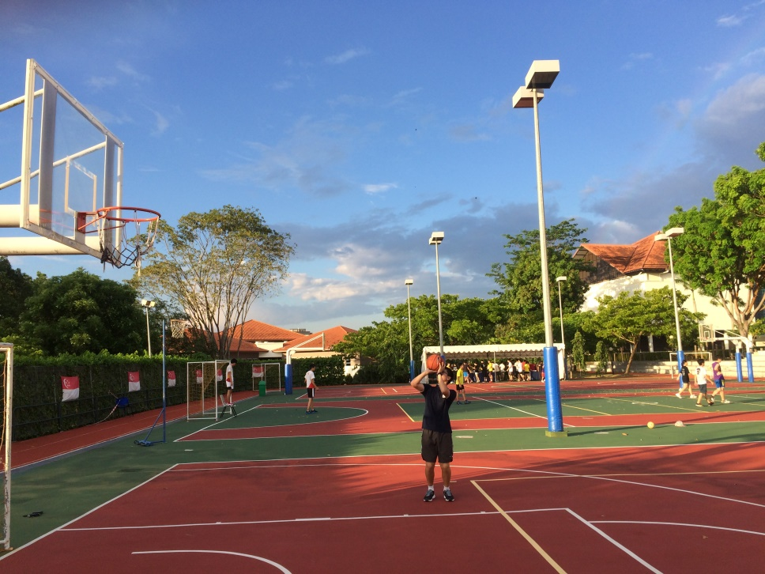
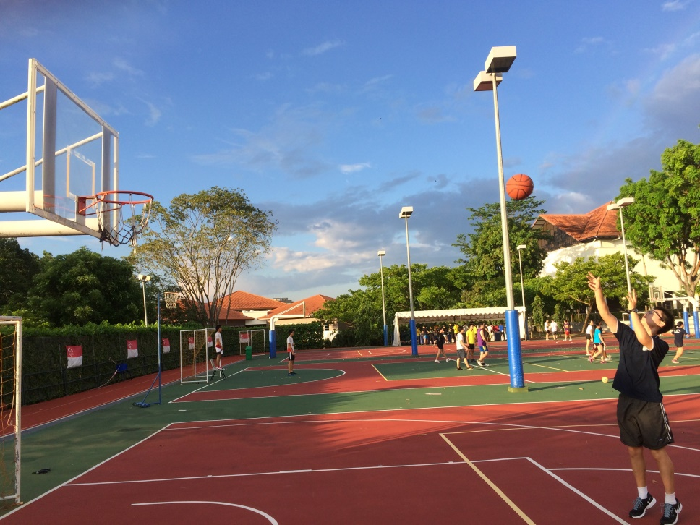
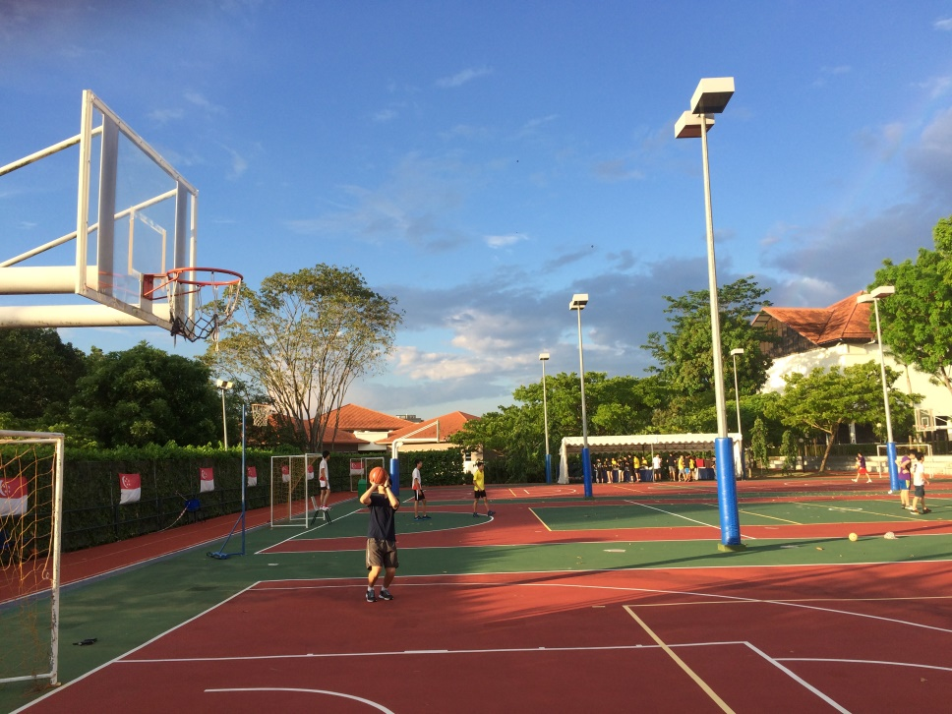
To find the trend of possibility of scoring in 3-D condition
2-D
3-D
V the launch speed
$β$ the launch angle
Optimum release height (h)
Shifting angle variation (γ)
Wiggle room (s)
Position of the player (x,𝜃)

Slide 12
Optimum release height
Shifting angle variation (γ)
Position of the player (x, 𝜃)
V the launch speed
$β$ the launch angle
𝛽 the launch angle
Wiggle room (s)

Slide 13
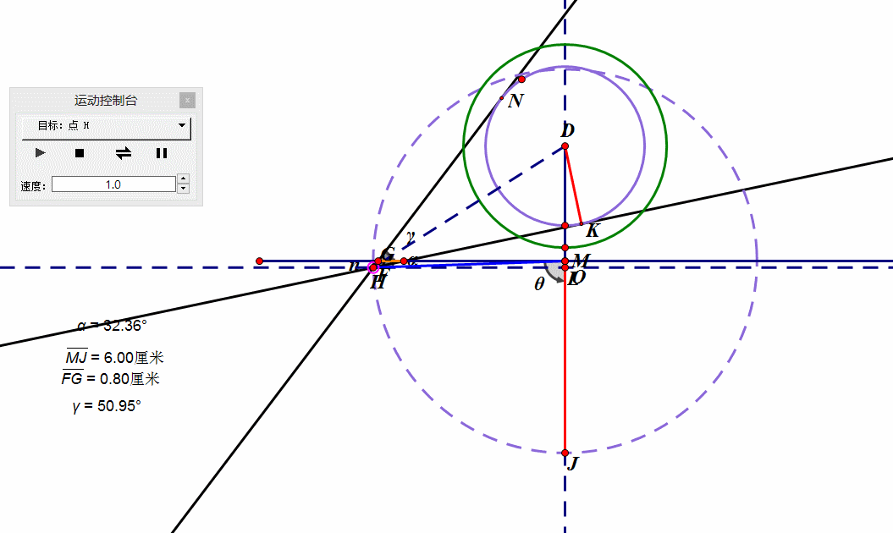
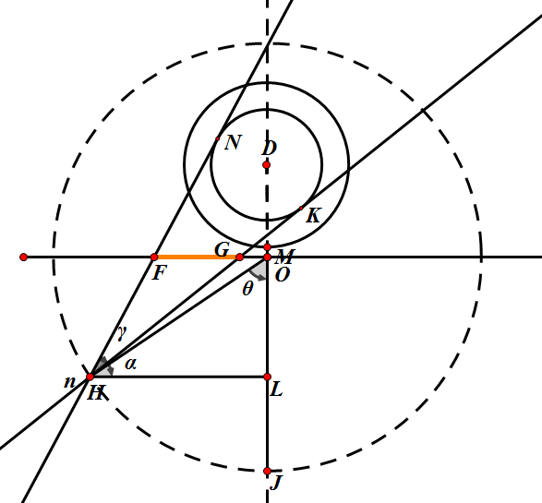
By using trigonometry functions and applying Pythagoras's Theorem：
$∠NHK\text{(}\text{γ}\text{)}$=2$∠$DHK =2$\sin^{−1}{\frac{r}{\sqrt{{\left(xcosθ+x \right)}^{2}+{(xsinθ)}^{2}}}}$
As θ decreases, ∠NHK (γ)also decreases
When θ reaches π/2,γ is the biggest.

Slide 14
Through calculation:
s(FG):
wiggle room
$$γ：∠NHK$$
$$α：∠DHL$$
Where:
$$γ=2\sin^{−1}{(\frac{r}{d})}$$
$$α=\tan^{−1}{\frac{x+x_{1}}{x\cos{θ}}}$$
Q
QG - QF

Slide 15
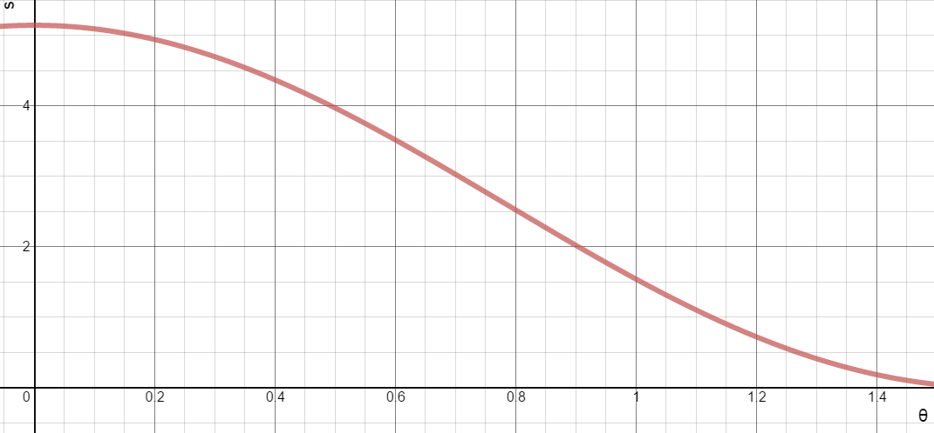
Substitute x, y and r by data and plot the graph
$$s$$
When$θ$increases, the wiggle room(s) decreases.
$$θ$$
Data retrieved from http://www.sportsknowhow.com/basketball/dimensions/nba-basketball-court-dimensions.html

Slide 16
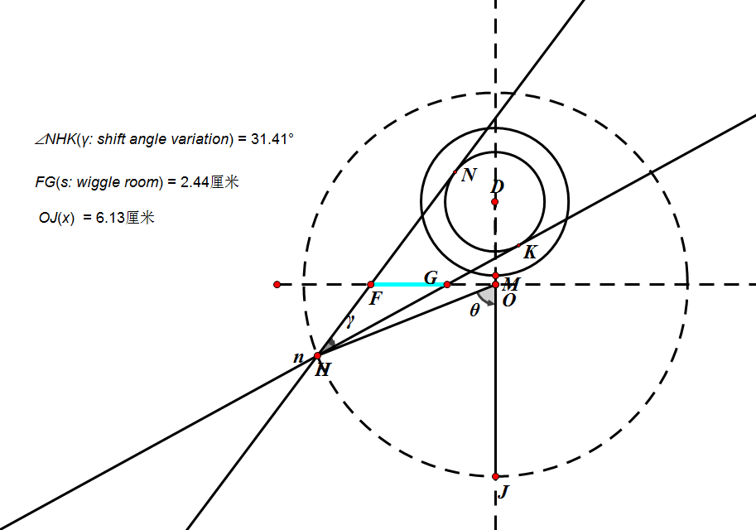
x increases the wiggle room(s) increases
x increases ∠NHK (γ) decreases

Slide 17
Optimum release height
Wiggle room (s)
Shifting angle variation (γ)
Position of the player (x, 𝜃)
V the launch speed
$β$ the launch angle
𝛽 the launch angle

Slide 18
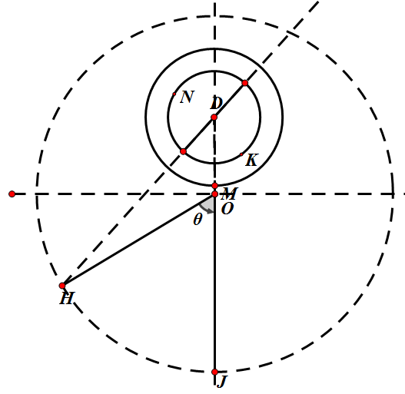
R
$x1=\sqrt{{(xsinθ)}^{2}{+(xcosθ+l)}^{2}}+r$
$x2=\sqrt{{(xsinθ)}^{2}{+(xcosθ+l)}^{2}}−r$
S
$$\int_{0}^{\frac{π}{2}}{v1\left(β\right)−v2\left(β\right)d\left(β\right)}$$
= $\frac{\frac{\sqrt{g{x1}^{2}}}{cosβ}}{\sqrt{2(x1tanβ−y)}} −$ $\frac{\frac{\sqrt{g{x2}^{2}}}{cosβ}}{\sqrt{2(x2tanβ−y)}}$

Slide 19
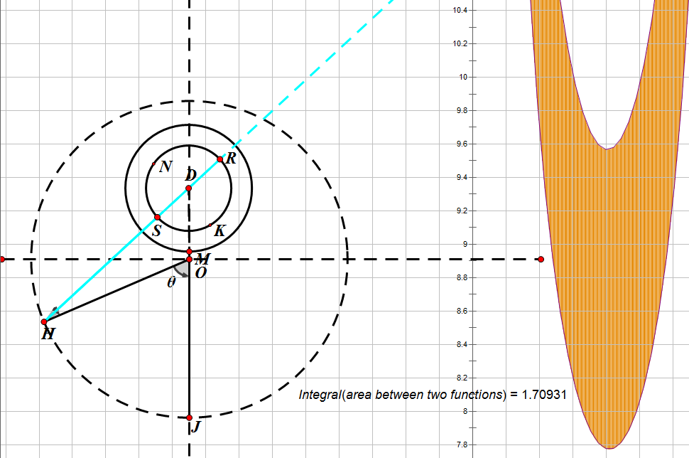
x decreases the range for $β$and v increases
𝜃 decreases the range for$β$ and v decreases

Slide 20
Optimum release height
Wiggle room (s)
Shifting angle variation (γ)
Position of the player (x, 𝜃)
V the launch speed
$β$ the launch angle
𝛽 the launch angle

Slide 21
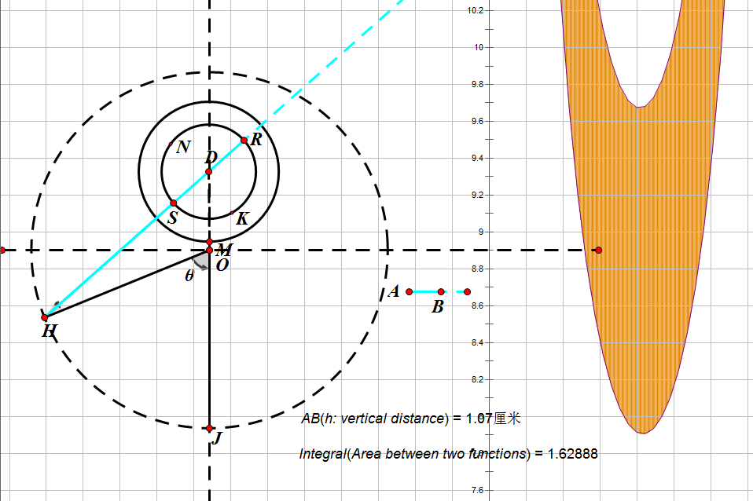
Release
the
ball
from
a
point
as
high
as
possible
$$\int_{0}^{\frac{π}{2}}{v1\left(β\right)−v2\left(β\right)d\left(β\right)=\frac{\frac{\sqrt{g{x1}^{2}}}{cosβ}}{\sqrt{2(x1tanβ−h)}}−\frac{\frac{\sqrt{g{x2}^{2}}}{cosβ}}{\sqrt{2(x2tanβ−h)}} }$$
To find the optimum release height of scoring on selected points on the court.
Change the value of h

Slide 22
conclusion
Objective 1
Objective 2
Objective 3
x increases the wiggle room(s) increases
x increases ∠NHK (γ) decreases
x increases ∠NHK (γ) decreases
𝜃 increases ∠NHK (γ) decreases
𝜃 increases the wiggle room(s) increases
x decreases the range for$β$and v increases
𝜃 decreases the range for$β$ and v decreases
By deducing the function and plot the graph, we can find the range of the launch speed and angle for scoring
2. To find the trend of possibility of scoring on selected points on the court in 3-D condition.
release height increases, the range for $β$and v increases
1.To find the relationship between launch angle and launch speed on selected points on the court in 2-D condition.
3. To find the optimum release height of scoring on selected points on the court.

Slide 23
References
Brabandere, S.D. (2014). Basketball: The Geometry of Banking a Basket Retrieved 12 February, 2015 from
http://www.sciencebuddies.org/science-fair-projects/project_ideas/Sports_p064.shtml#procedure
Begley, S
Duan, R. (2009). The physical model of basketball shooting motion track and hitting rate Science and Technology Consulting Herald Year 2009 number 20 Retrieved on 2 Feb 2015 from
Gorski, C. (2011). Best “sweet spots” on the backboard Retrieved on 24 Feb 2015 from
http://phys.org/news/2011-03-sweet-backboard.html
http://wenku.baidu.com/view/1812a541336c1eb91a375d61.html
“Nothing but net?” (2011).Basketball science has more answers Retrieved on 24 Feb 2015 from
http://www.reuters.com/article/2012/07/21/us-oly-science-bask-adv- idUSBRE86K0BG20120721

Slide 24
References
Silverberg, L.M. (2012). & Wagner, K. (2012). Science Has Calculated the Perfect Basketball Shot Retrieved on 14 Feb 2015 from
http://gizmodo.com/5928074/science-has-calculated-the-perfect-basketball-shot
Sports know how.com PROFESSIONAL-NBA BASKETBALL COURT DIMENSIONS NBA Basketball Court Layout Diagram retrieved on 30 June 2015 from
http://www.sportsknowhow.com/basketball/dimensions/nba-basketball-court-dimensions.html
Yan, S.S. (2008). Interesting physics in ball games Physics 37 volume year 2008 number 7 Retrieved on 1 Feb 2015 from
http://scholar.google.com.sg/scholar_url?url=http%3A%2F%2Fwww.wuli.ac.cn%2FN%2Farticle%2FdownloadArticleFile.do%3FattachType%3DPDF%26id%3D31255&hl=zh-CN&sa=T&oi=ggp&ct=res&cd=5&ei=lz3QVOm7MceEqgGQ9YHYCA&scisig=AAGBfm3XcoVU6si-tVR5aBJXA1fUTY9inA&nossl=1&ws=1366x673

Slide 25
Web Report
Mibmathinbasketball.weebly.com

Slide 26
Limitation
Assume zero air resistance.
Assume non-rotating basketball with unlimited speed.
Assume no energy lost when the ball hits the board.

Slide 27
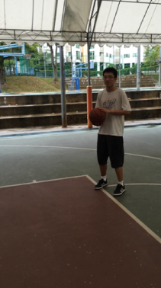
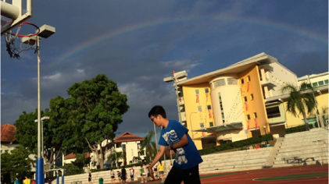
Further research
Rotation of the basketball
Brick: A shot that hits the basket

Slide 28
Acknowledgement

Slide 29
Thank you

Slide 30
ANY QUESTIONS?
Picture taken form:
http://satorifrenzy.deviantart.com/art/MIB3-wallpaper-by-satorikun-302439924

